Slide 1
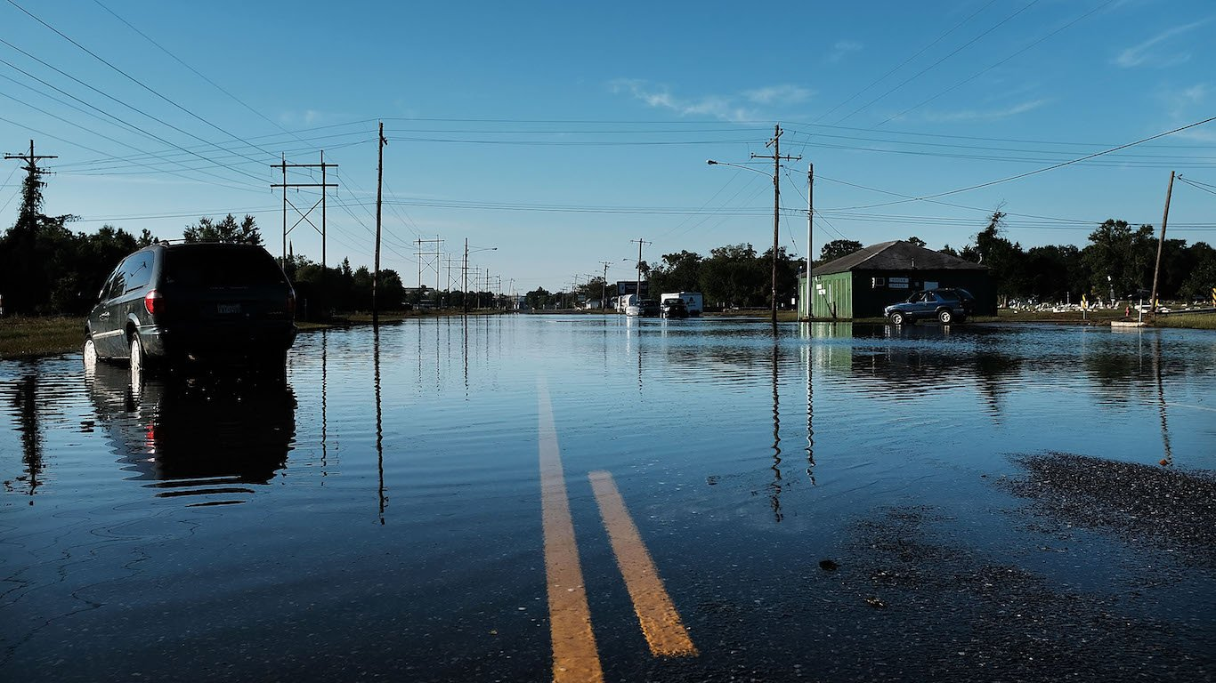
FLOOD PREDICTION USING MACHINE LEARNING ALGORITHM
BY TEAM-: TECH TITANS

Slide 2
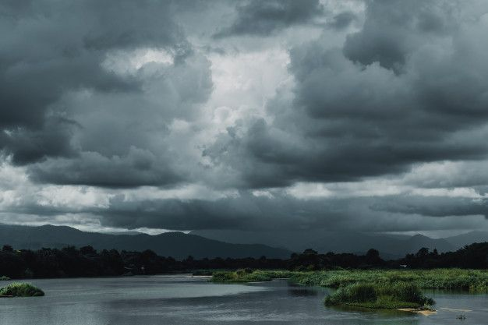
FLOOD PREDICTION USING MACHINE LEARNING ALGORITHM
Introduction to flood prediction system
Floods are among the most devastating natural disasters, causing significant loss of life, property, and infrastructure. Accurate and timely flood prediction is crucial for mitigating these impacts. This story outlines the design and implementation of a flood prediction system leveraging machine learning algorithms to provide reliable forecasts and help communities prepare for impending floods. Here is a visual story illustrating the design and implementation of a flood prediction system using machine learning algorithms by Flood Forecaster.

Slide 3
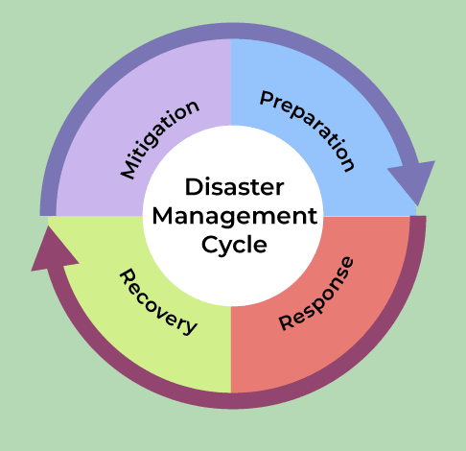
FLOOD PREDICTION SYSTEM
THE PROBLEM
Flooding is a perennial problem. Every monsoon season, the towns especially near water bodies, braces for potential flooding, which disrupts lives and economic activities. The town's existing flood warning system is based on historical patterns and manual monitoring, often failing to provide timely and accurate predictions. Thus it is necessary to develop a flood prediction model using machine learning techniques and Python programming language.
Key challenges
Data Scarcity: Limited historical flood data and real-time monitoring capabilities.
Rapid Response Needed:
The town requires immediate and precise warnings to mitigate the effects of floods.
Inaccurate Predictions: Current methods lack precision, often issuing false alarms or missing floods altogether.

Slide 4
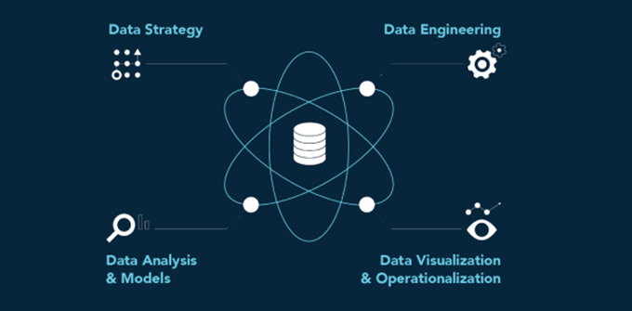
FLOOD PREDICTION
Formulating the Solution
To address these challenges, a team of data scientists, meteorologists, and local authorities come together to develop an advanced flood prediction system using machine learning. The goal is to harness historical data, real-time weather data, and hydrological information to predict floods more accurately and provide timely warnings.
Components of the Solution:
Data Collection: Aggregating historical flood data, weather patterns, river water levels, soil moisture, and precipitation data.
Feature Engineering: Identifying key indicators and patterns that precede flooding events.
Model Selection: Evaluating various machine learning algorithms to determine the most suitable for flood prediction.
Real-Time Processing: Integrating real-time data feeds for dynamic prediction updates.

Slide 5
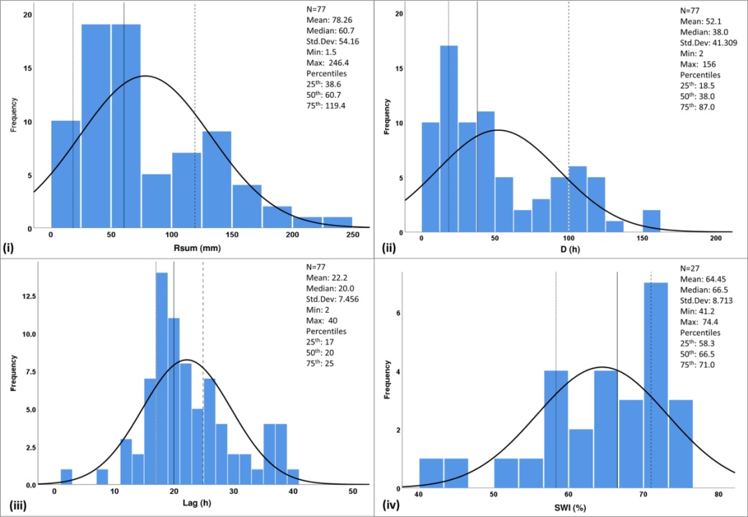
Building the System
Data Collection and Preprocessing
Historical data from local government records, weather stations, and satellite images. Real-time data from IoT sensors placed at critical points along the river and around the town.
Feature Engineering
Analyzing historical flood events to identify common features. Creating new variables like rainfall intensity, river flow rate, and soil saturation levels.
Model Development
Algorithm Selection: After experimenting with various algorithms, the team selects Gradient Boosting, Random Forest, and LSTM (Long Short-Term Memory) networks due to their robustness in handling time-series data. Training and Validation: Using historical data to train the models and validate their accuracy against known flood events.
System Integration
Real-Time Data Pipeline: Setting up an automated pipeline to continuously feed real-time data into the prediction model. Alert System: Developing a user-friendly interface that provides alerts and visualizations of flood predictions to local authorities and residents

Slide 6
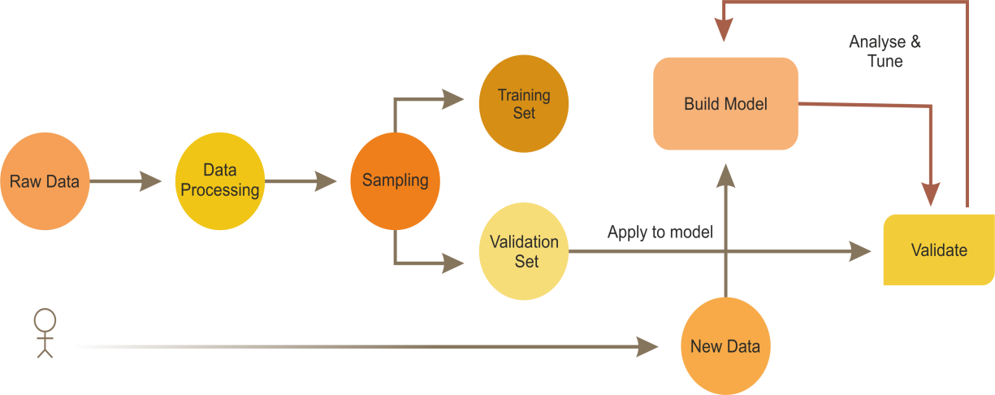
Impact and Future Prospects
Immediate Benefits:
Enhanced Preparedness: Timely and accurate flood warnings help in better prepare and respond to floods.
Reduced Damage: Early warnings allow for evacuation and protection of property, significantly reducing the impact of floods.

Slide 7
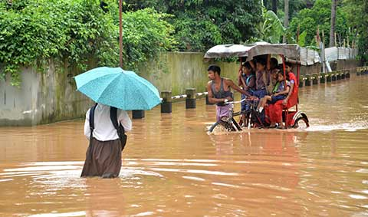
Impact and Future Prospects
Long-Term Vision:
Scalability:
Expanding the system to other flood-prone regions.
Continuous Improvement:
Leveraging more advanced machine learning techniques and incorporating additional data sources for improved accuracy.
Community Engagement:
Involving the community in data collection and response strategies, fostering a culture of preparedness and resilience.

Slide 8
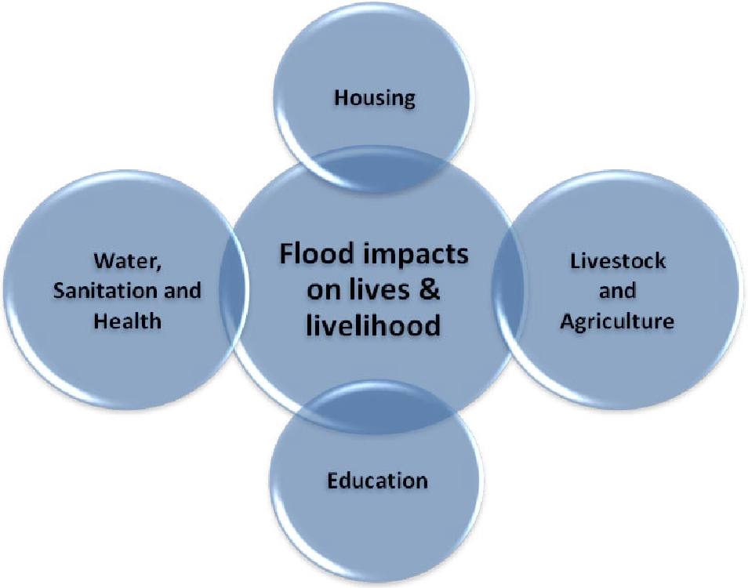
Implementation and Testing
Pilot Phase:
Implementing the system on a trial basis in River Ville for one monsoon season. Monitoring the system's predictions and comparing them with actual flood events. Feedback and Refinement Gathering feedback from local authorities and residents. Refining the model based on the performance during the pilot phase, addressing any discrepancies or false alarms.
Full Deployment:
Rolling out the refined system for full-scale deployment. Conducting training sessions for local authorities on interpreting the predictions and taking necessary actions.

Slide 9
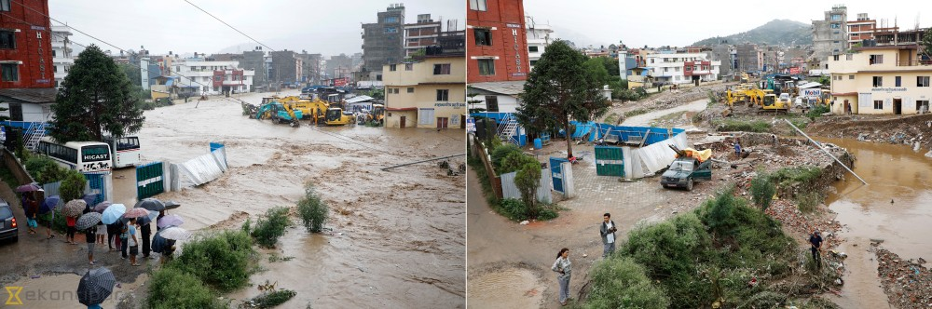
Epilogue: A Call to Action
As Flood Forecaster Pro thrives with its new flood prediction system, the story serves as a call to action for other communities. Embracing technology and collaborative efforts can pave the way for safer, more resilient futures in the face of natural disasters.

Slide 10
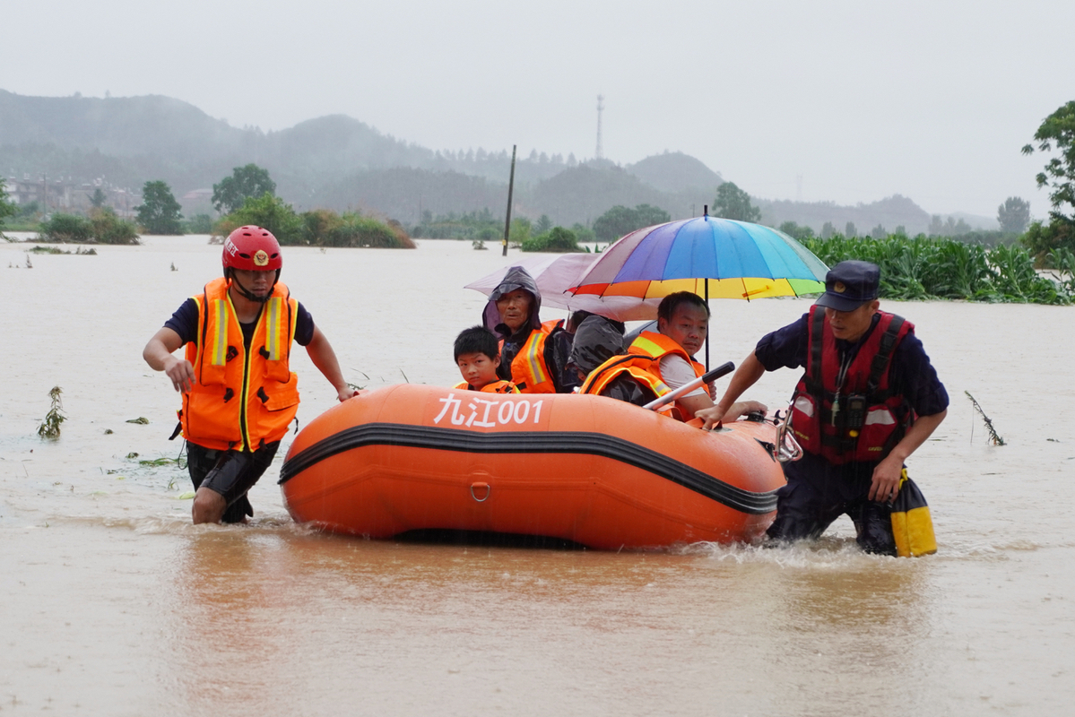
CONCLUSION
The flood prediction system developed by Flood Forecaster Pro is a testament to the power of machine learning in solving real-world problems. By leveraging historical data, real-time information, and advanced algorithms, the town is now better equipped to face the challenges posed by floods. This initiative not only safeguards lives and property but also sets a precedent for innovative disaster management solutions worldwide.

Slide 11


